Slide 1
HUMAN RESOURCE MANAGEMENT
“You can get capital and erect building
but it takes people to build a business”.
–Thomas J Watson, Founder, IBM
MB 206
TOPIC : 1

Slide 2
COURSE COVERAGE
Human Resource Management :
Scope and coverage,
Structure and functions of HR department,
Role of HR manager.

Slide 3
What is HRM?
Human Resource Management is a series of integrated decisions that form the employment relationship; their quality contributes to the ability of the organizations and the employees to achieve their objective.
__________George T.Milkovich & Johri W.Boudreau
Human Resource Management is concerned with the people dimension in management. Since every organisation is made up of people, acquiring their services, developing their skills, motivating them to higher levels of performance and ensuring that they continue to maintain their commitment to the organisation are essential to achieving organisational objectives. __________David A Decenzo & Stephen P Robbins

Slide 4
Human Resource Management is the planning, organising, directing and controlling of the procurement, development, compensation, integration, maintenance and separation of human resources to the end that individual, organisational, and social objectives are accomplished.
__________Edwin B Flippo

Slide 5
Evolution of HRM in India
Labour Officer : - Recruiting - Record keeping - Labour laws
Statutory Requirements - Working Conditions - Safety - Welfare
# Tata Steel Works, Jamshedpur (Mr Naoroji)
# Royal Commission on Labour, 1931 – recommended Labour Oficer for factories
# Bombay Mill Owners’ Association, 1935
# Indian Jute Mills Association, 1936
Labour Welfare Officer : Statutory Requirements under Factories Act, 1948 and Mines Act, 1952 – 500/more workers
Personnel Officers/managers (Legal Experts) [ Rise of TUs: Increase in Legal process] – Time keeping - Security - Wage - Administration

Slide 6
Early 60s : Management Schools : Specialists
- Legal, Organisational, Personnel Related
Support to Operations as subsidiary & not as direct contributing team member
Open Organisational Culture, Environment of Trust & Dependence, Freedom of Decision Making, Motivated Employees
HUMAN RESOURCE MANAGEMENT : Pro-active function

Slide 7
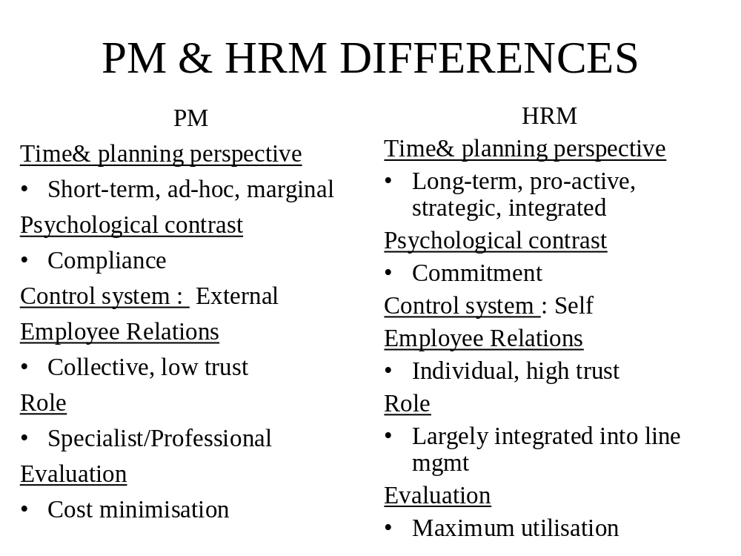

Slide 8
Structure of HR Deptt
Place of HR Deptt in overall set up
- Small Organisation
Manager
Production Mgr Sales Mgr Office Mgr Accountant
Personnel Assistant
- Large scale Organisation
CMD
Director- Prodn Director- Fin Director- HR Director - Mkt

Slide 9
HR Function in a Corporate
CMD
Dir ( HR )
GM ( CSR )
GM ( Admin & Welfare )
GM ( PR )
GM ( HR )
GM (HRD)
GM ( Vigilance )
VARIOUS DESIGNATIONS IN HR
DIRECTOR – HR GM – HR / ED – HR DGM – HR
SENIOR MANAGER – HR CHIEF MANAGER – HR
MANAGER – HR DEPUTY MANAGER – HR
PERSONNEL OFFICER SENIOR PERSONNEL OFFICER

Slide 10
Functions
OBJECTIVES : of HR functions include:
Effective utilisation of Human resources
Desirable working relationship
Maximum individual development
Traditionally the functions are:
Attracting and retaining talents through Selection & Staffing
Creating and running systems and processes for managing people through:
training and development
compensation and rewards management
performance management
industrial relations management
Human Resource Information Systems management

Slide 11
Functions
Currently, the functions are:
Helping an organisation achieve its business objectives through designing, developing and implementing people and performance management strategies through:
1.Human Resource Planning : Job Analysis, Forecasting & Inventory, Recruitment & Selection, Placement & Induction
2. Human Resource Development : Performance Appraisal, Training, Motivation, Management Development, Career Planning, Organisational Development
3. Compensation Management : Job Evaluation, Wage & Salary Administration, Incentives, Social Security
4. Employee Relations : Relations with Trade Unions, Communication, Negotiation, Grievance handling, Counselling
5. HR Evaluation : Audit, Research & Analysis, HR Accounting

Slide 12
Recruitment &
Selection
“All we can do is bet on the
people whom we pick. So my
whole job is picking the
right people.”
Jack Welch
CEO, General Electric

Slide 13
Vision & Mission
Statements
Business
Plans of the
organization
Internal
Promote
Transfer
Job Analysis
External
Employment
Exchange
Advertisement
Campus
Agencies/Consultants
References
Online
Others
-Forced Applicants
-Died in Harness
-Sons of the soil
-Retd employees’
children
MANPOWER
PLANNING
(Job requirements)
Position-wise
Job Description &
Job Specification
Recruitment
(How many,
where,
what, when)
Procedure
Sources
Policy
Preparation of Notification
Pool of potentially
qualified Job
Applicants
RECRUITMENT PROCESS
Receiving
Applications

Slide 14
RECRUITMENT POLICIES
INTERNAL FACTORS
ORGANISATIONAL POLICIES
AGREEMENT BETWEEN MANAGEMENT & UNION
EXTERNAL FACTORS
PROVISIONS UNDER THE CONSTITUTION OF INDIA
- Article 16 under Fundamental Rights (Right to Equality)
- Article 16 under Fundamental Rights (Rights against Exploitation)
- Article 46 : SC, ST and other weaker sections
- Industrial Disputes Act, 1947 : Retrenched employee
- Employment Exchanges (Compulsory Notification of Vacancies) Act, 1957
- Apprentices Act, 1961
- Contract Labour (regulation & Abolition) Act, 1970
COURT ORDERS: INJUNCTIONS, AWARDS, BANS
ECONOMIC FACTORS – MARKET VOLATILITY, ENVIRONMENTAL UNCERTAINTY, RECESSION ETC.
TECHNOLOGICAL CHANGES – CONTINUOUSLY CHANGING PRODUCTION LINE PRACTICES NECESSITATING CHANGES IN SKILL PROFILE REQUIRED OF EMPLOYEES, FAST CHANGES IN MARKET DEMANDS, CHALLENGES IN THE CONTEMPORARY BUSINESS ETC.

Slide 15
PROCEDURE
Job Analysis - Process of obtaining and analyzing information about the job
Job Description - An organized, factual statement of duties & responsibilities of a specific job
Job Specification - Statement of knowledge, skills and abilities necessary to perform a job properly

Slide 16
SOURCES OF RECRUITMENT
Recruitment can broadly be divided into two categories :-
Internal recruitment
External Recruitment, from outside markets
Internal Recruitment
Vacancies are made known to own employees and they are asked to apply for the posts if they fulfill the criteria of qualifications, age, experience and personal profile (to fit with the attributes required of the job holder).
Internal applicants undergo test/ interview in a similar manner as if they were external candidates.
Preference over external candidates and some times they are treated exactly at par with external candidates till the appointment is made.
Bilateral agreement with the management

Slide 17
External Recruitment
Notifying the vacancies through
Employment exchange as required by Compulsory Notification of Vacancies Act., 1959, if there are already more than 25 employees in the organization.
Private employment agencies, including head hunters
Professional associations such as Institute of Engineers, All India Medical Association, All India Management Association, Institute of Chartered Accountants etc.
Campus recruitment
Leading newspapers (Advertising)
References : Political leaders, union executives
On-line
Others : Forced applications, Died in harness, sons of the soil, etc.

Slide 18
ADVANTAGES /DISADVANTAGES
INTERNAL
FAMILIARITY
BETTER USE OF TALENT
ECONOMIC
EASILY AVAILABLE
MOTIVATOR
DISADVANTAGES
INBREEDING
LACK OF VARIETY
HIGH TRAINING COST
EXTERNAL
NEW BLOOD
NEW INSIGHT/PERSPECTIVE
LESS CHANCE OF GROUPISM
DISADVANTAGES
ADJUSTMENT PROBLEM
LONGER ORIENTATION TIME
ATTITUDE OF EARLIER ORGN
MAY SELECT WRONG MAN

Slide 19
ADVANTAGES /DISADVANTAGES
EMPLOYMENT
Economic (no cost)
Negligible loss of time
Good source
ADVERTISING
Right candidates apply
Wide choice
CAMPUS
Economic (no cost)
Wide choice among desired quality of students
EXCHANGE
Limited choice
Low caliber
High Training cost
ADVERTISING
High cost
Time consuming
Administration of large no. of candidates at each stage
CAMPUS
Generally no work history
High aspirants
Adaptation to orgn. culture is long

Slide 20
ADVANTAGES /DISADVANTAGES
PLACEMENT AGENCIES
Accuracy with JD & JS
Less time consuming
Professional approach
Confidential
REFERENCES (POLITICAL LEADERS, UNION LEADERS, etc.)
Economic
Pre-disposed to accept work environment
Loyal to organisation
ON-LINE
Wider reach
Low cost
Time saving
Wider choice
Quality data collection
OTHERS
Economic
Known as individuls
Knowledge of the company
PLACEMENT AGENCIES
Limited choice
May be poor fit to JD & JS
Old inventory
Costly
REFERENCES (POLITICAL LEADERS, UNION LEADERS, etc.)
Limited choice
High training cost
Embarrassment if rejected
ON-LINE
Response not limited to right catchment area
OTHERS
May be unemployable
Adjustment difficulties with old employees
Limited choice

Slide 21
Selection Process
RECRUITMENT : POOL
OF POTENTIALLY
QUALIFIED JOB
APPLICANTS
METHODS OF SELECTION
WRITTEN/
TRADE TEST
SCREENING
APPLICANTS:
BASIS –
NOTIFICATION
GROUP DISCUSSION
SELECTION
PROCESS
SELECTION
PROCEDURE
INTERVIEW
FIXING CRITERIA:
1/2/3 TIER SELECTION
RESERVATION
ELIMINATION CRITERIA
ENCLOSED DOCUMENTS
EVALUATION
PANEL
VERIFICATION:
HEALTH, REFEREE,
POLICE, VIGILANCE
HIRING DECISION
ISSUE OF
APPOINTMENT LETTER

Slide 22
Testing for Employee Selection
Uses of Tests
  Reliability (repeatability of test results)
  Validity (measures what it purports to measure)
Types of Tests : Written or Psychometric
  Intelligence
  Mechanical comprehension
  Personality and interests
  Ability/achievement (current capabilities/knowledge)
  Aptitude (performance potential)
  Management assessment center

Slide 23
Psychometric Tests: examples
PERSONALITY TESTS
16PF (Personality Factors)
MBTI (Myers-Briggs Type Indicator)
FIRO – B (Fundamental Interpersonal Relationship Orientation Behaviour)

Slide 24
GROUP DISCUSSION
Topic discussed among a group for 15-20 minutes
Types:
Normal
Case Study
Role Play
Stress (Abstract topic)
Judges: Communication, Comprehension, Logic, Leadership, etc.

Slide 25
Interviewing: Purpose
Interviewer gets to know the candidate
Candidate gets to know about the job being offered
Candidate gets to know the organisation in which the work is done
TYPES:
Preliminary Interview : preliminary screening to determine whether a detailed interview will be worthwhile.
Extensive Interview : In-depth Interview May be structured/ unstructured.
Stress Interview – Deliberate attempts to create pressure to observe how an applicant performs under stress.
PROCESS: 3 Step
Step One Define the Job
Step Two Assess the Candidate
Step Three Document & Decide

Slide 26
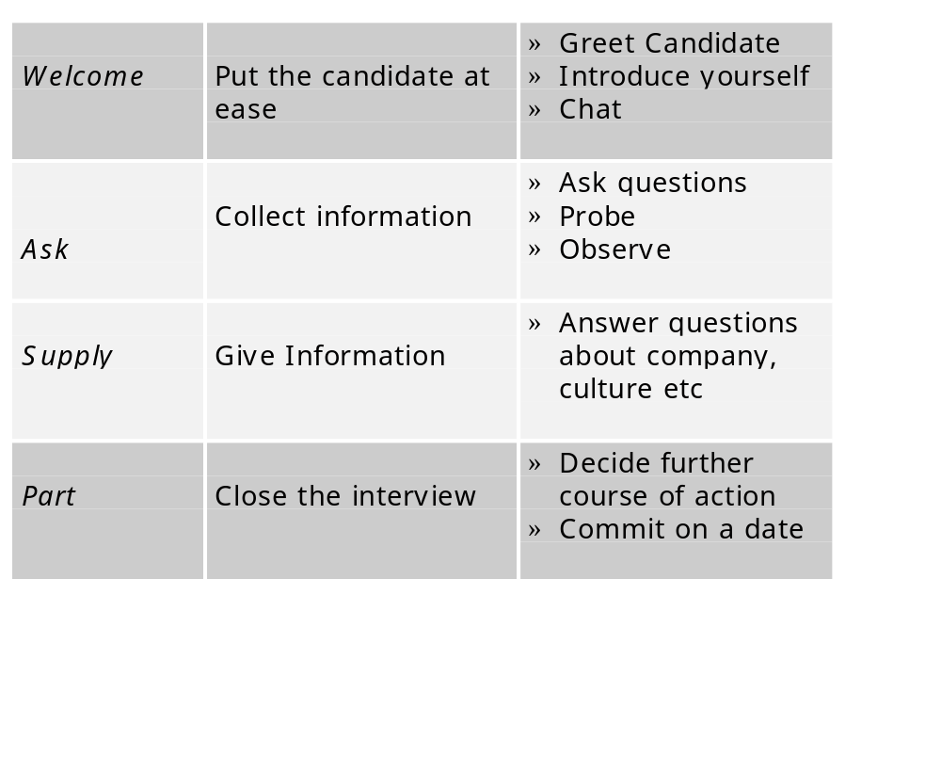
W-A-S-P Interview

Slide 27
ADVANTAGES/DISADVANTAGES
Potential for Collecting Information –
Potential for Giving Information
Human Aspect-
Disadvantages of Interviewing
Too many complexities are tested in too little time
Artificial situation – result may reveal that candidate is good in interviewing but may not be good at work
The interviewee is always on his guard and does not expose the weaknesses – may choose the wrong man
Time consuming procedure

Slide 28
Potential Biases in Interviews
Halo Effect – attach very high value to one particular characteristic which dominates the appraisal of his entire personality
Leniency – in ratings by a panel one rater can show consistent leniency by giving high scores and the other may give low scores. Leniency indicates lack of confidence and interest in rating
Projection – when interviewer expects his own qualities, skills, values in an applicant and resembles candidates similar to him in terms of age, appearance, manners, opinions and background
Stereotyping – when interviewers have already formed some mental association between a particular trait, culture and personality, i.e, holds a stereotype of what represents a good applicant
Central Tendency – interviewers tend to rate a candidate in the medium scale, say in a 5 point scale, tendency to rate at 3.

Slide 29
Potential Biases in Interviews (cont’d)
Negative information is given unduly high weight
The interviewer may make a decision concerning the applicant’s suitability within the first four or five minutes of the interview
The interviewer may forget much of the interview’s content within minutes after its conclusion

Slide 30
VERIFICATION
HEALTH/ MEDICAL
- Check physical fitness
- protect against unwarranted claims for compensation
- proper job distribution
REFEREE
POLICE

Slide 31
Letter of Initial Offer
Date
<Name of the selected candidate>
<Address>
Dear Mr. / Ms. .............,
Welcome to (Organization Name)!
It gives us great pleasure to offer the role of _____________, for which you interviewed with us.
This job, as explained to you, is in the Management Grade ______ of our company. The compensation and other benefits that you would be entitled to are stated in the enclosure to this letter. We request you to go through the same and return the enclosed duplicate copy of this letter in acceptance of the same.
Accordingly, we will arrange to issue to you a detailed letter of appointment on the date of your joining us, which we agreed between us will be any day on or before ________.

Slide 32
The role, in which you join us, is a very important one which will entail dealing with important and sensitive information, records and such other matters of the company. You will, therefore, be required to sign a “Code of Conduct and Secrecy Agreement” of our company at the time of your joining the company.
We look forward to you joining our team. We are sure that you will have a bright career with our company.
We take this opportunity to welcome you and your family into the folds of our company.
Kind Regards
<Name of the Business Leader>
<Designation>
<Company>

Slide 33
Training & Development

Slide 34
Concept of Training & Development
TRAINING is a learning process that involves the acquisition of knowledge, sharpening of skills,
concepts, rules, or changing of attitudes and behaviours to enhance the performance of employees.
Training seeks a relatively permanent change in an individual that will improve his/ her ability to perform on the job. It involves changing of Skills, Attitude and Knowledge

Slide 35
DEVELOPMENT helps the individual handle future responsibilities, with less emphasis on present job duties.
It is more future oriented and more concerned with education than training.
Management Development activities attempt to instill sound reasoning processes to enhance one’s ability to understand and interpret knowledge.
It focuses on the personal growth & on Analytical, Conceptual and Human skills.
Learning is a relatively permanent change in behavior that results from direct or indirect experience.

Slide 36
Difference Between Training & Development
Training
Operatives
Develops special skills
One-time process
Initiative comes from management
Result of external motivation
Preparation to meet present need of individual
Reactive process
Development
Executives
Develops total personality
Continuous process
Initiative comes from
self
Result of internal motivation
Preparation to meet future need of individual
Pro-active process
http://www.scribd.com/doc/32808023/training-and-development

Slide 37
What is Training need?
Discrepancy/ gap between what an organisation expects to happen and what actually occurs
What is Needs Assessment?
Process by which an organisation’s training needs are identified and articulated. It identifies performance requirements and the gap between what performance is required and what presently exists.

Slide 38
Purpose
Objective analysis of organisation’s training requirements
Foundation for effective HRD effort
Identifies :
Where & what kind of programme/interventions are needed
Who needs to be included
Whether there are any roadblocks to their effectiveness
Type of Needs
Performance Deficiency
Democratic
Pro-active - Diagnostic - Analytic
Compliance

Slide 39
Methodology
Training Needs Identification
Organisational Level Individual Level
Organisational Analysis
Task Analysis Man Analysis

Slide 40
Organisational Analysis
Process used to better understand the characteristics of the organisation to determine where training & T&D efforts are needed and conditions within which they will be conducted
Task Analysis/ Operations Analysis
Systematic collection of data about a specific job or group of jobs to determine what an employee should be taught to achieve optimal performance
Man Analysis
Determines training needs of individual employees
Focus is on how well each employee is performing his key
tasks

Slide 41
Training Methods - Types
On the Job Training
Job Instruction Training
Job Rotation
Coaching &
Mentoring
Off the Job Training/Class room Training
Lecture
Conference
Audio-Visual
Experiential Techniques : Case Study, Business Games, In-Basket Exercise, Vestibule Training, Role Play
Sensitivity Training
Self-Paced Training
Computer-based Training : Multimedia CD Rom; Intranet /Internet

Slide 42
Non Training Methods
Job Enrichment : Vertical job loading; employees at lower levels assigned jobs previously done by employees of one level up
Job Enlargement : Horizontal job loading
Job Rotation
Group Level Interventions
Team building refers to transformation of groups into Autonomous Work Teams horizontally
Motivation, Participation in development and implementation of more efficient operation methods with least supervisory and control activities.
Ouality Circle, Think Tank Teams (T Team, Japan), Zero Defect, America, Shop Improvement Group, India, Etc.

Slide 43
Evaluation: Definition
The systematic collection of descriptive and judgemental information necessary to make effective training decisions related to the selection, adoption, value and modification of various instructional activities (Goldstein, 1986)

Slide 44
Reasons for Evaluating Training
Companies are investing millions in training programs to help gain a competitive advantage, they expect the outcomes or benefits related to training to be measurable.
To identify the program’s strengths and weaknesses.
To assess whether content, organization, and administration of the program contribute to learning and the use of training content on the job.
To identify which trainees benefited most or least from the program.

Slide 45
Reasons for Evaluating Training
To determine the financial benefits and costs of the programs.
To compare the costs and benefits of training versus non-training investments.
To compare the costs and benefits of different training programs to choose the best program.
To gather data to assist in marketing training programs.

Slide 46
Training evaluation involves:
Formative evaluation – evaluation conducted to improve the training process.
Summative evaluation – evaluation conducted to determine the extent to which trainees have changed as a result of participating in the training program.

Slide 47
4 Level Training Outcomes by Donald KirkpatrickMeasuring ROI of Training.ppt
L1 – Reaction :
Administered immediately after the training
Data compiled into reports
L2 – Knowledge / Learning :
Measures Change in Learning
Pre and Post
L2 can be
  Measure change noticed by Manager
  Measure change noticed by Self
  Measure change through a neutral assessment

Slide 48
4 Level Training Outcomes by Donald Kirkpatrick
L3 – Behavior
Measures change in actions or new behavior
Participants follow an action plan & report it
Post Training Workshops
Success Case Studies
L4 – Results
Measures business results
Difficult to measure because of dynamic external variables that impact results too
L4 can be implemented if Training Department is involved in ‘Consulting’ along with training

